Slide 1






Proctoring clear
0 violations · 32:14
app.quippy-lab.com/speaking
Run High-Stakes Language Exams You Can Fully Trust
Speaking · Part 2
Auto-graded
8.0
/ 10
Fluency
8.4
Vocabulary
7.8
Ideas
7.9

Slide 2


Who is
?
The all-in-one language exam platform for the modern institution — delivery, proctoring, and grading across all four skills.

Slide 3





THE PROBLEM
Traditional Testing is Slow, Subjective, and Hard to Scale.
Grading is slow &
inconsistent
Proctoring is
labor-intensive
Speaking & writing
are subjective
Results take
too long

Slide 4








THE SOLUTION
One Platform, End to End.
Deliver
Proctor
Grade
Schedule, register candidates, and launch secure exams from one dashboard.
Real-time AI monitoring flags violations and keeps integrity intact.
AI scores all four skills in seconds, with teachers in the loop where it matters.
Listening
Reading
Writing
Speaking
Notes:
‹#›

Slide 5
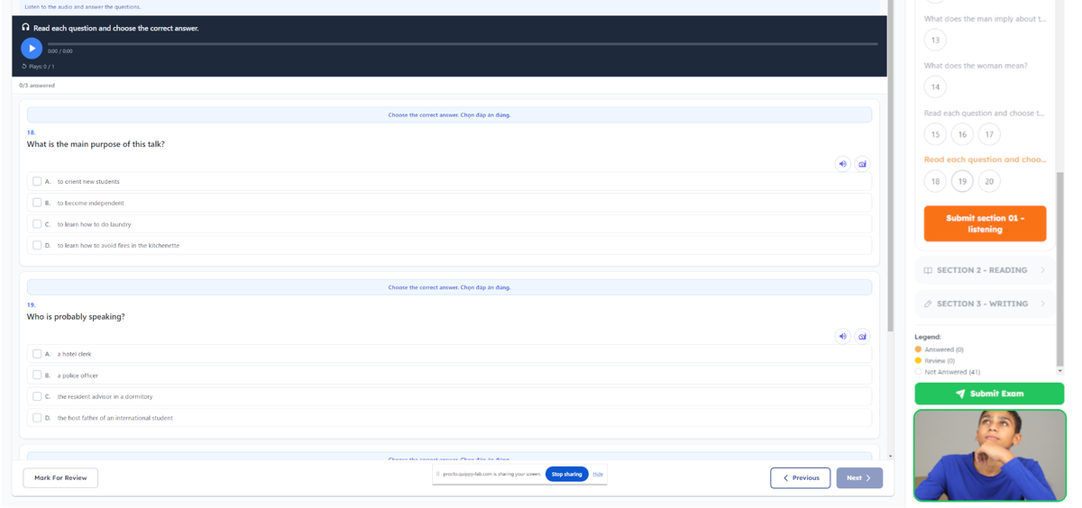



KEY FEATURE · AI PROCTORING
Integrity, without an invigilator in every room.
Detects prohibited objects
Phones, notes, and second faces, with a confidence score.
Logs every violation
Timestamped and severity-ranked for fast review.
Frees up your staff
One teacher oversees many sessions at once.
Notes:
‹#›

Slide 6
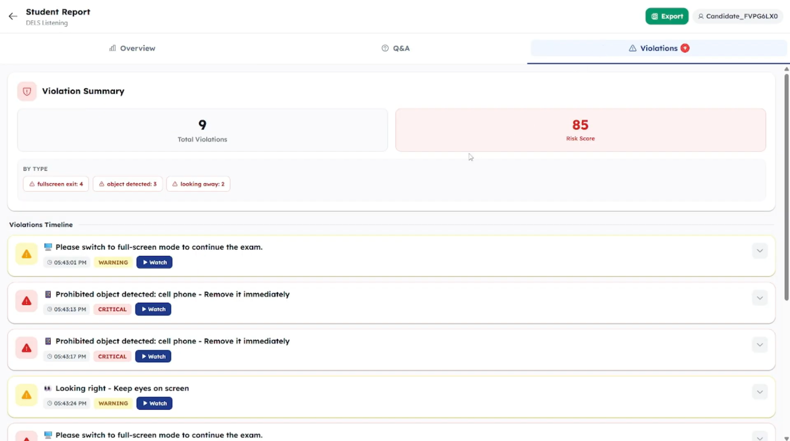
AI PROCTORING
Every flag, reviewed in one place.
Notes:
‹#›

Slide 7

KEY FEATURE · FLEXIBLE EXAM MODES
Choose the workflow that fits.
AI
Auto-Grade
Fully automated marking with no proctor needed — ideal for practice tests and placement at scale.
Proctor +
Examiner Marking
Instant scores, all 4 skills
AI proctoring secures the session while your examiners mark — the familiar process, made faster.
Zero invigilation overhead
Full Exam —
AI + Teacher
Run anytime, anywhere
AI monitoring & violation log
Hybrid grading: AI does the first pass, teachers review and adjust. Speed with full oversight.
Human examiner scoring
Audit-ready records
AI first-pass on every script
Teacher override on any score
Best balance of speed & trust
Notes:
‹#›

Slide 8
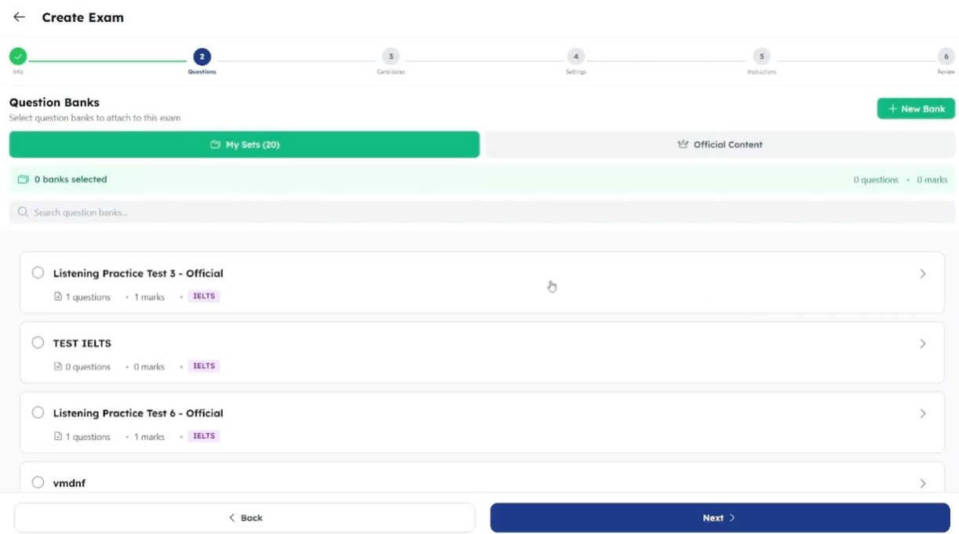
KEY FEATURE · QUESTION BANK & AI GENERATOR
Build exams faster.
Notes:
‹#›

Slide 9
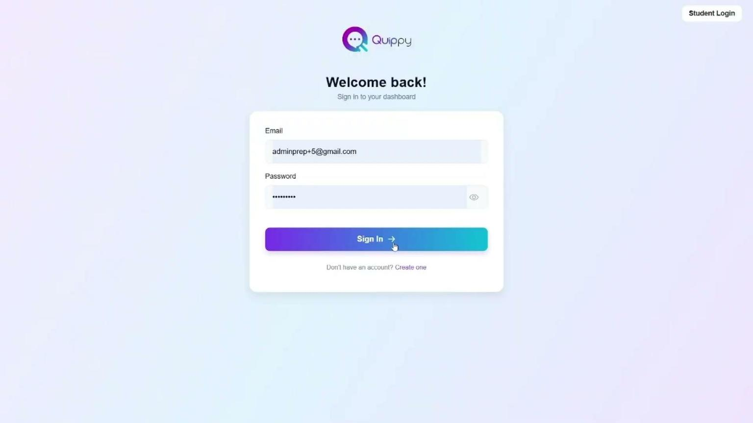


Tutorial Video
Notes:
‹#›

Slide 10





Our Partners
Schools · Universities · Language Centres · Education Partners

Slide 11

Book Your Live Demo Today!
quippy.co
info@quippy.co

